Slide 1
Online Text Chatting System

Slide 2
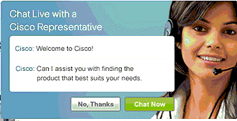
Why Online Text Chatting System?
One of oldest communication system in computer age.
We still use it.
Fast and reliable.
Comparable with all technology on cyber net.

Slide 3
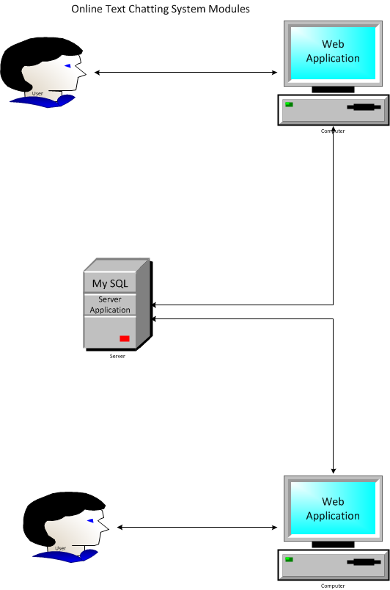
NON- Functional Requirements
R1. The system SHALL be Client/Server architecture.
R2. Client and server SHALL use different operation systems.
R3. Client and server SHALL use different programming languages.
R4. Server SHALL connect to database.

Slide 4
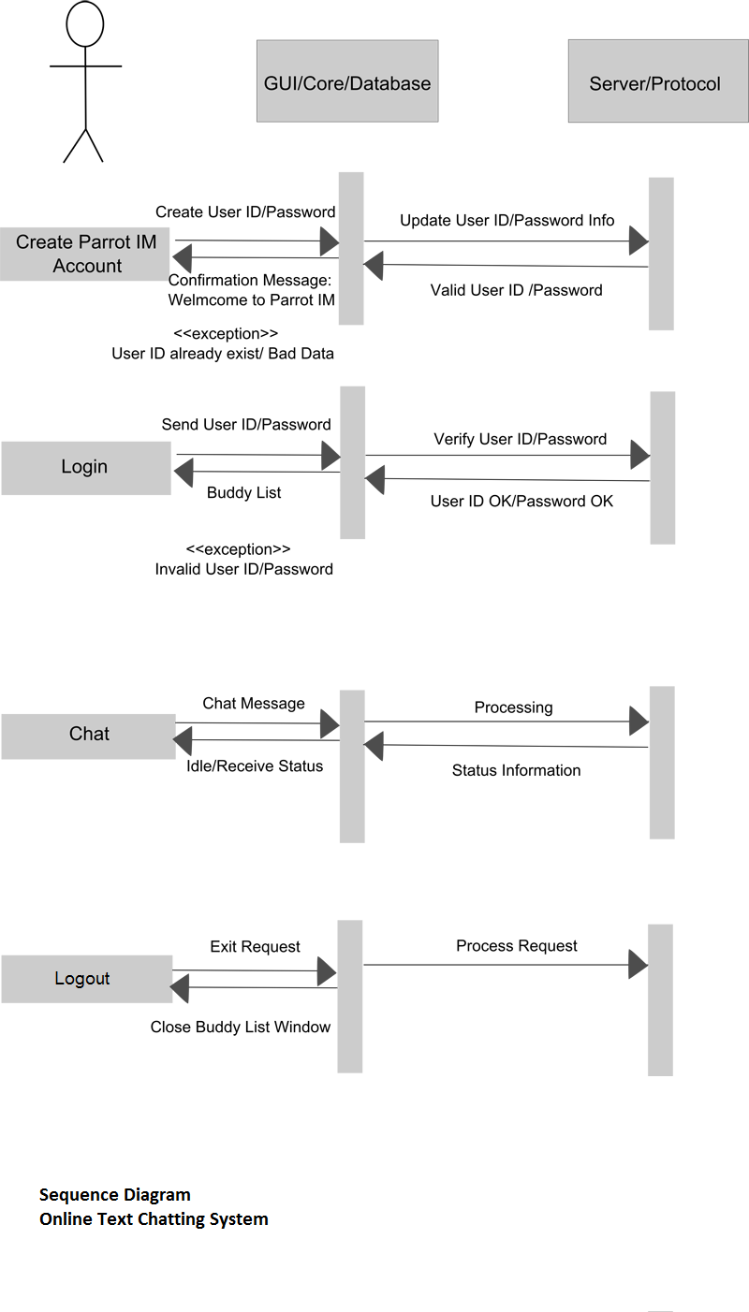
Functional Requirements
FR1. User SHALL be able to register into system.
FR2. User SHALL be able to login to start chat.
FR3. User SHALL be able to logout to close communication section.
FR4. User SHALL be able to choose chat room if it is available.
FR5. User SHALL be able to send and receive text.

Slide 7
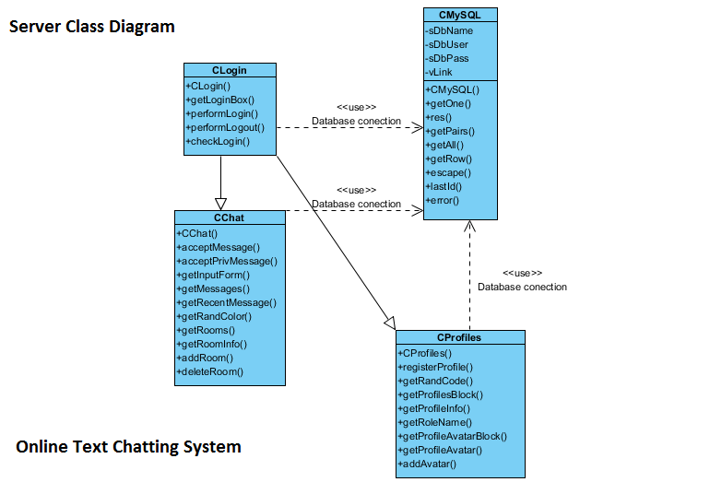

Slide 8
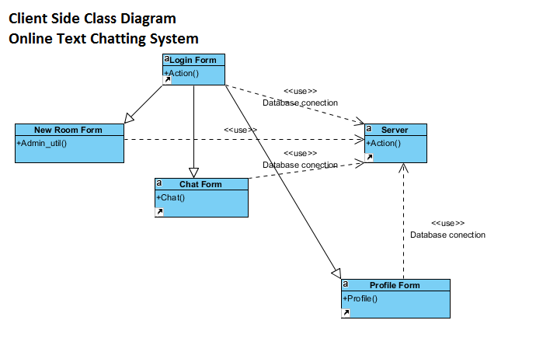

Slide 9


